Slide 1

Object Classification in Urban Aerial Drone Footage
Jack, Aidan, Liam

Slide 2
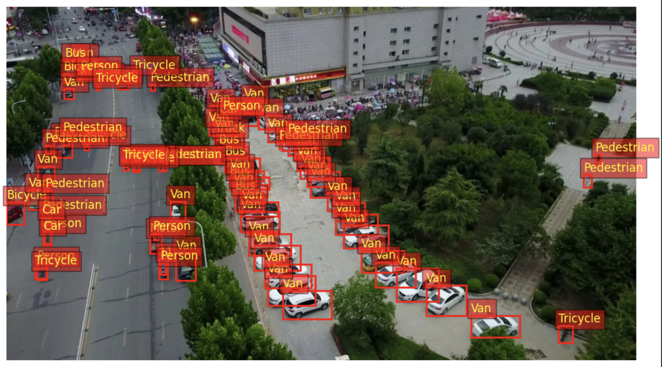
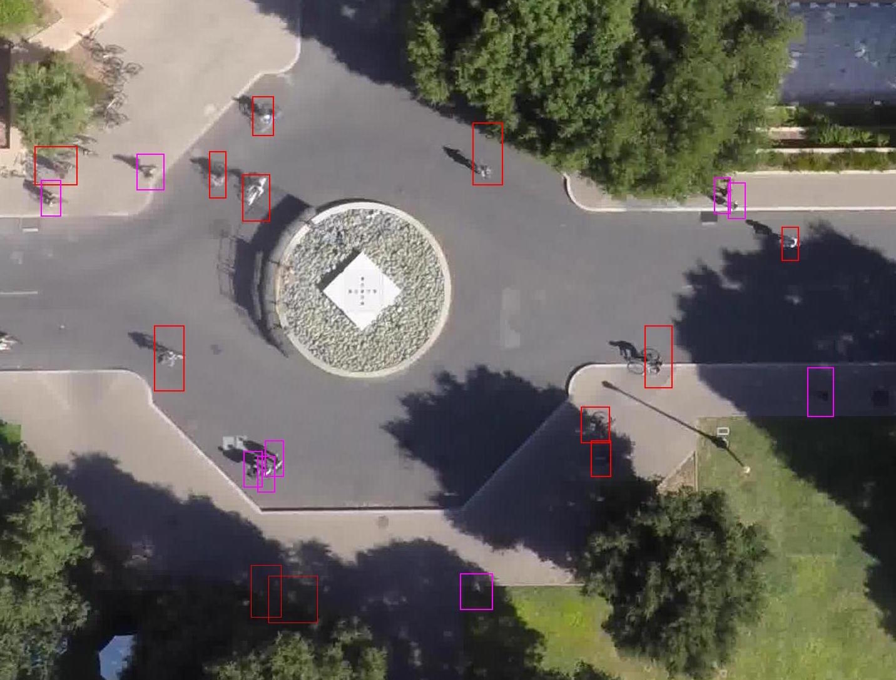
Project Recap
Objective:
Create a computer vision object classification model to identify objects in aerial drone videos
Prior Research:
Stanford Drone Dataset
Our dataset:
VisDrone Dataset
300 videos, ~260,000 frames of urban Chinese cities

Slide 3
Baseline Model
PyTorch Torchvision Faster R-CNN
Object detection model pre-trained on COCO
330,000+ images and wider variety of locations
Includes same VisDrone classes (Pedestrian, Car, etc…)
Simple CNN model
Small # of parameters (2-3 layers, no drop-off or optimizations, etc)

Slide 4
Our Model Architecture
Transfer Learning:
Load pretrained ResNet-50 or -101 model with FPN (better suited for drone images)
Freeze or allow fine-tuning
Remove original detection layers (head)
Region Proposal Network (RPN):
Use built-in RPN layers to generate regions
Anchor box tuning as needed (e.g. smaller sizes)
Region of Interest (ROI) Head:
Customize ROI detection box head layers with dropout regularization
Add final box predictor, specified for VisDrone data
Training Optimizations:
Data augmentation
Optimizers (SGD with momentum, L2 regularization)
Learning rate scheduling
Early stopping

Slide 5
Evaluation Criteria
Modeled off VisDrone’s official competition criteria:
Average Precision: “quality”
Precision = TP / (TP + FP)
Measures the accuracy of classifications and precision of bounding boxes
Intersection over Union (the closeness of two bounding boxes)
Average Recall: “quantity”
Recall = TP / (TP + FN)
Measures the model’s ability to find all the relevant objects in an image

